Slide 1
Unit 5: Geological Time Vocabulary

Slide 2
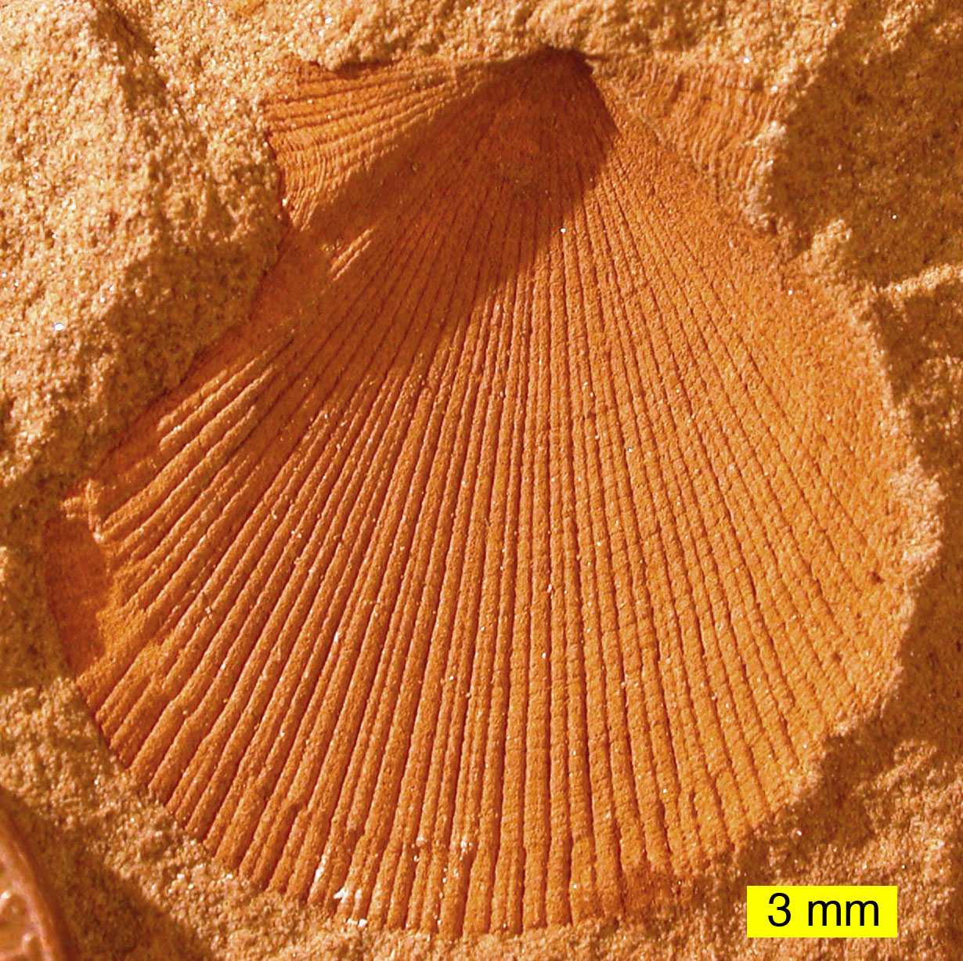
Mold
A fossil when an organism buried in sediment dissolves, leaving a hollow area.

Slide 3
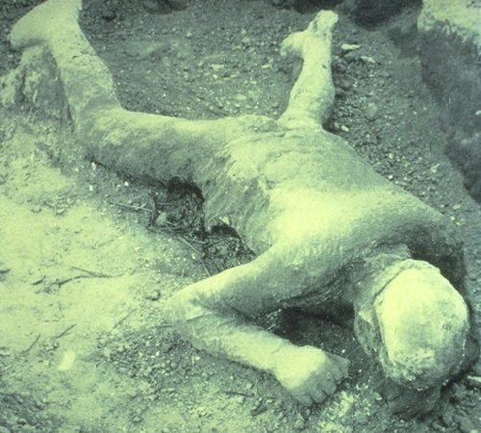
Cast
A fossil that is copy of an organism’s shape, formed when minerals seep into the mold.

Slide 4
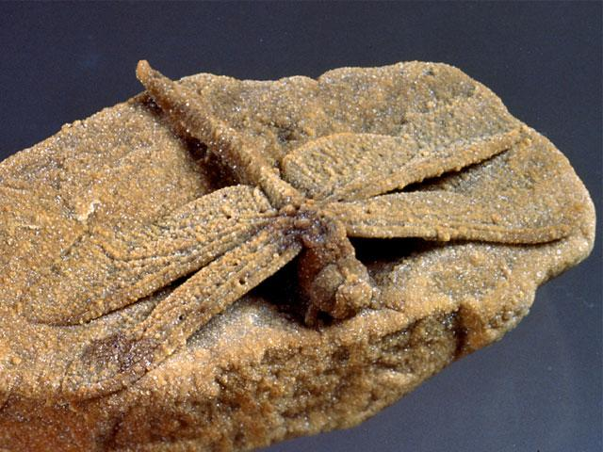
Petrified Fossils
A fossil in which minerals replace all or part of an organism.

Slide 5
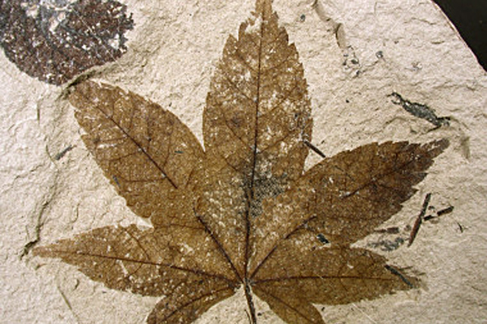
Carbon Film
A type of fossil consisting of an extremely thin coating on rock..

Slide 6
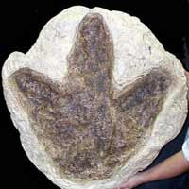
Trace Fossils
A type of fossil that provides evidence of the activities of ancient organisms.

Slide 7
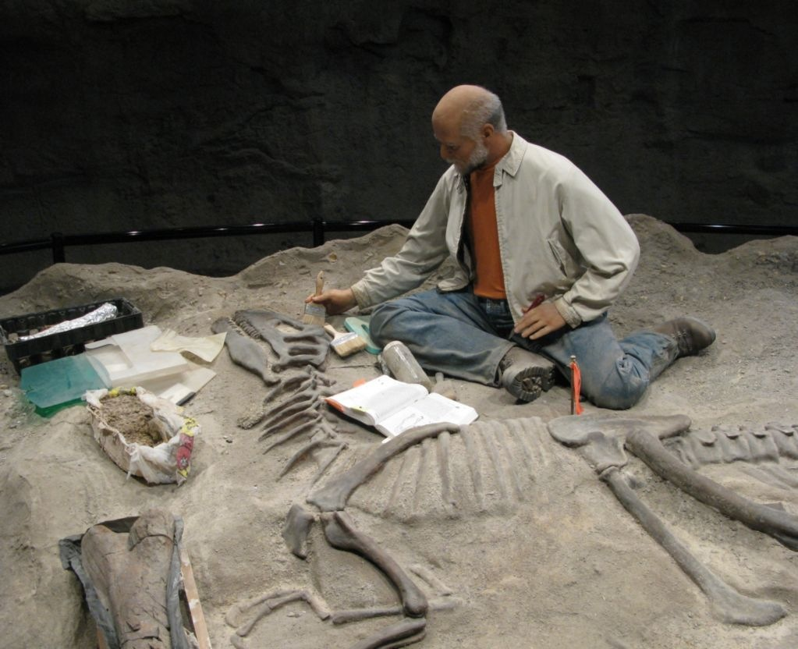
Paleontologist
A scientist who studies fossils to learn about organisms that lived long ago.

Slide 8
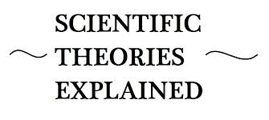
Scientific Theory
A well-tested concept that explains a wide range of observations.

Slide 9
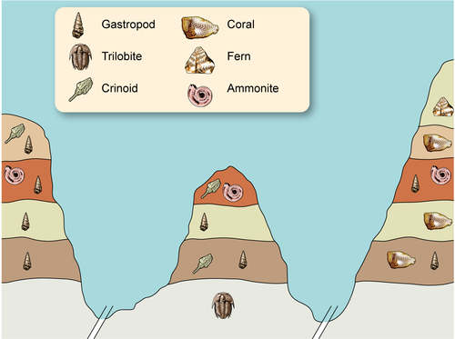
Relative Age
The age of a rock compared to the ages of rock layers.

Slide 10
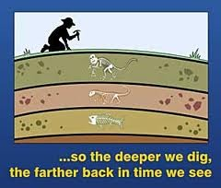
Absolute Age
The age of a rock given as the number of years since the rock formed.

Slide 11
Law of Superposition
The geologic principle that states that in horizontal layers of sedimentary rock, each layers is older than the layer above it and younger than the layer below it.

Slide 12
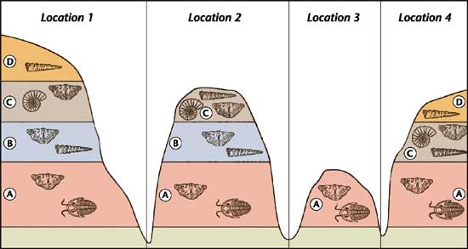
Index Fossils
Fossils of widely distributed organisms that lived during only one short period.

Slide 13
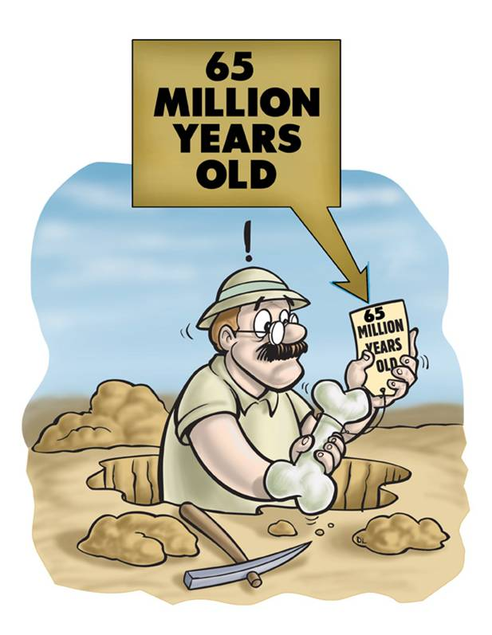
Radioactive Decay
The breakdown of an radioactive element, releasing particles and energy.

Slide 14
Half Life
The time it takes for half of the atoms of a radioactive element to decay.

Slide 15
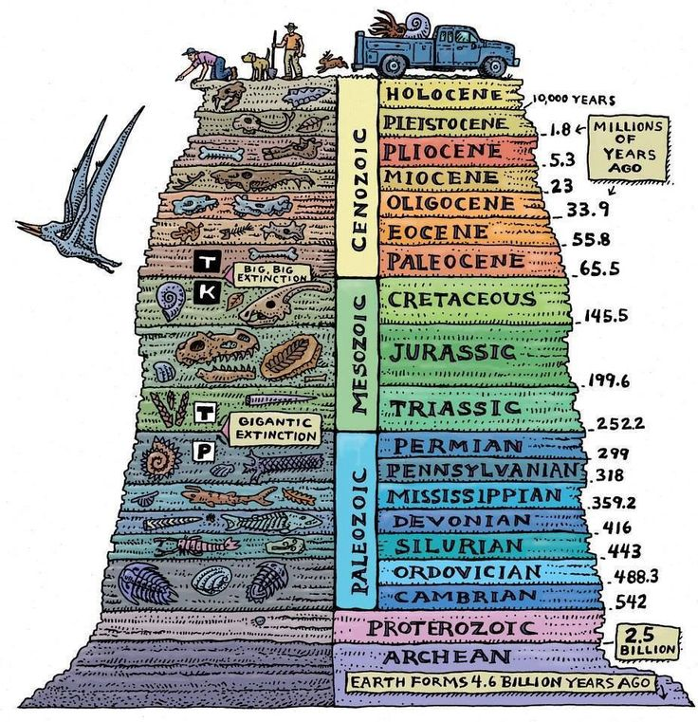
Geologic Time Scale
A record of the geologic events and life forms in Earth’s history.

Slide 16
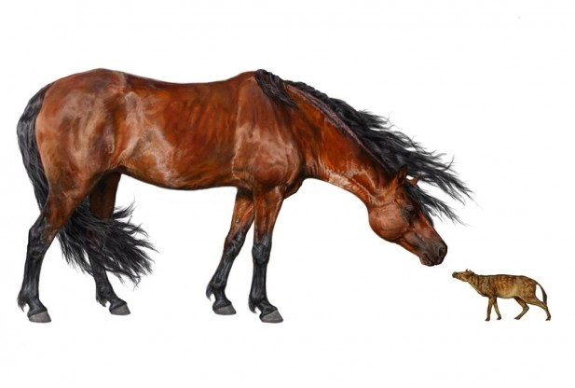
Era
One of the three long units of geologic time between the Precambrian and the present.

Slide 17
Periods
One of the units of geologic time into which geologists divide eras.

Slide 18
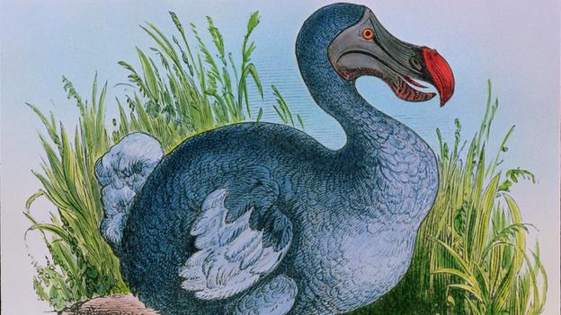
Mass Extinction
When many types of living things become extinct at the same time.

Slide 19
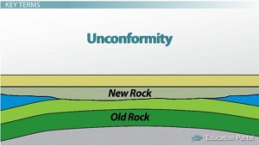
Unconformity
A place where an old, eroded rock surface is in contact with a newer rock layer.

Slide 20
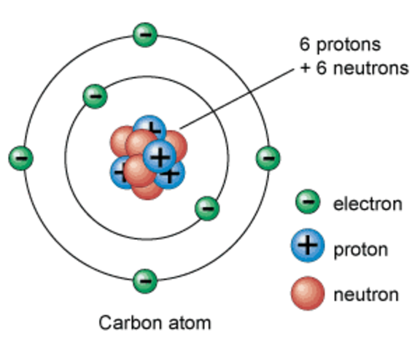
Atom
The smallest particles of an element.

Slide 21
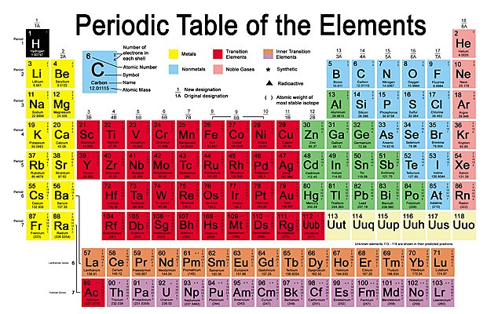
Element
A substance in which all the atoms are the same that cannot be broken down in to other substances.

