Slide 1
Unit 1 Vocabulary
Science Skills

Slide 2
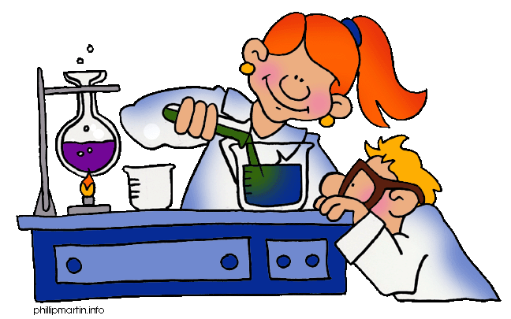
Science
A way of learning about the natural world through observations and logical reasoning; leads to a body of knowledge.
(Page 6)

Slide 3
Predicting
The process of forecasting what will happen in the future based on past experience or evidence.
(Page 7)

Slide 4
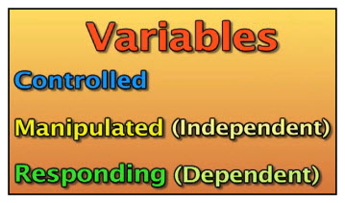
Variable
A factor that can change in an experiment.
(Page 9)

Slide 5
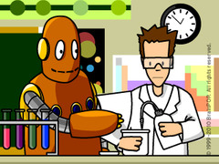
Manipulated Variable
The one factor that a scientist changes during an experiment; also called independent variable.
(Page 9)

Slide 6
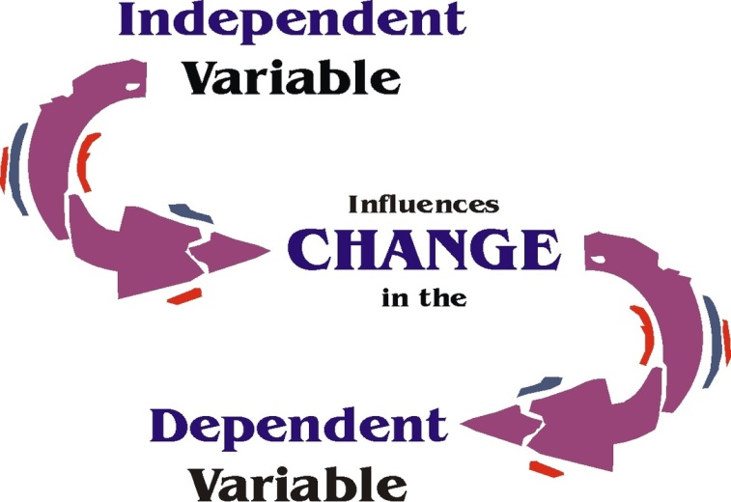
Responding Variable
The factor that changes as a result of changes to the manipulated, or independent, variable in an experiment; also call dependent variable...
(Page 9)

Slide 7
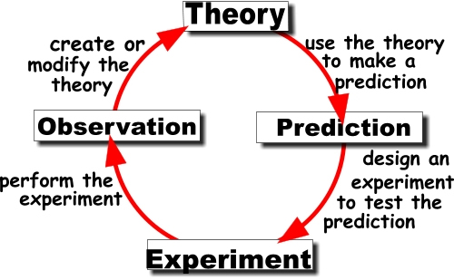
Scientific Theory
A well-tested concept that explains a wide range of observations.
(Page 12,106,246)

Slide 8
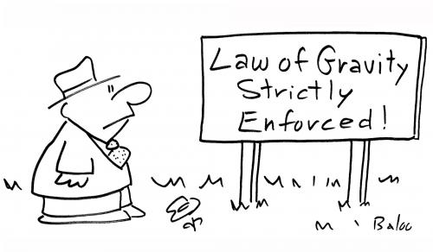
Scientific Law
A statement that describes what scientists expect to happen every time under a particular set of conditions.
(Page 12)

Slide 9
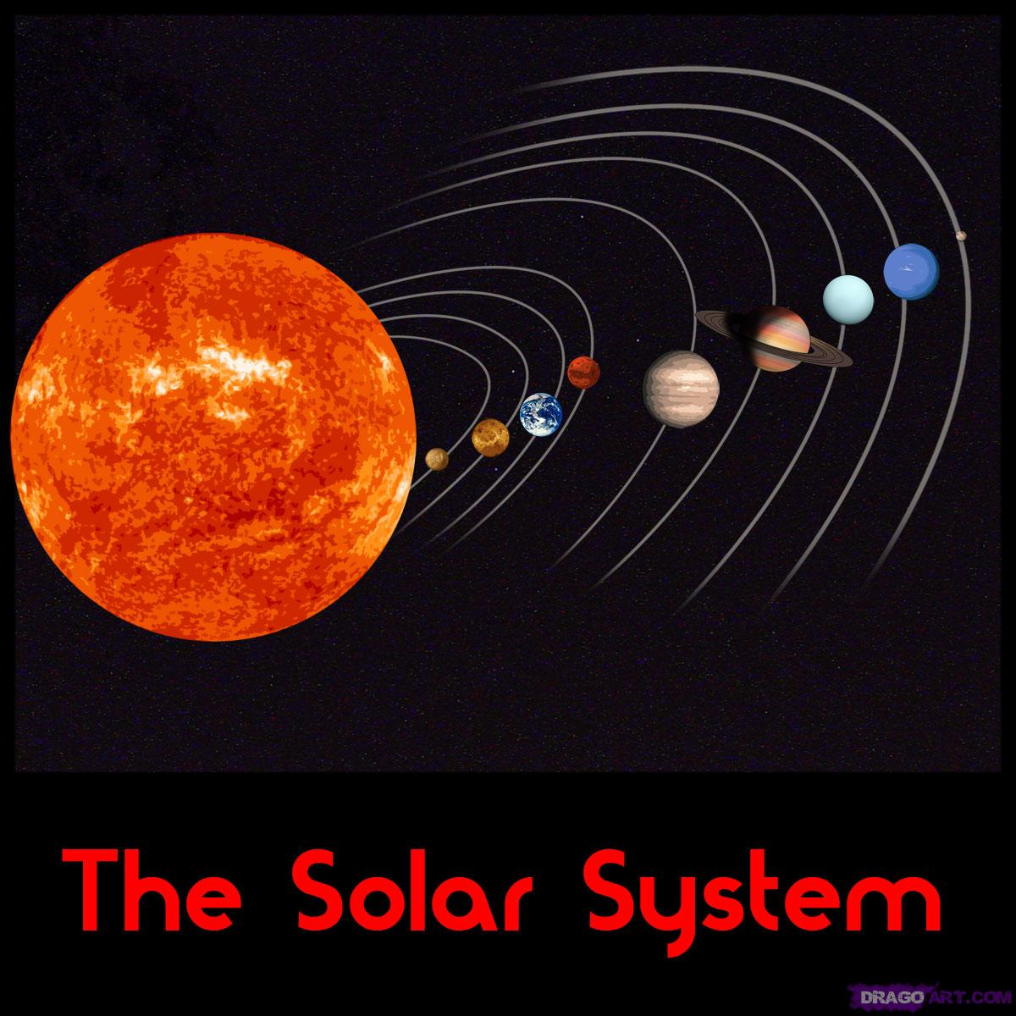
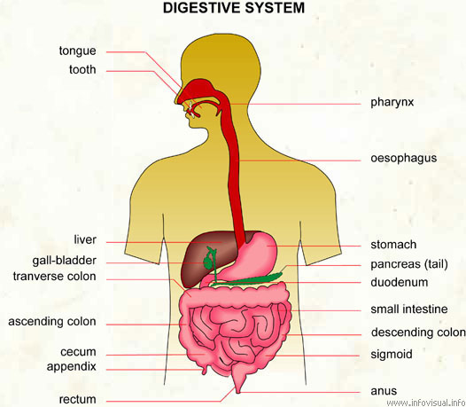
System
A group of related parts that work together.
(Page 14)

Slide 10
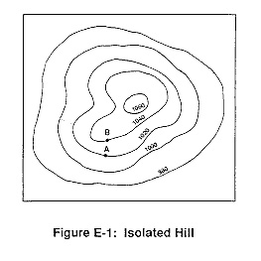
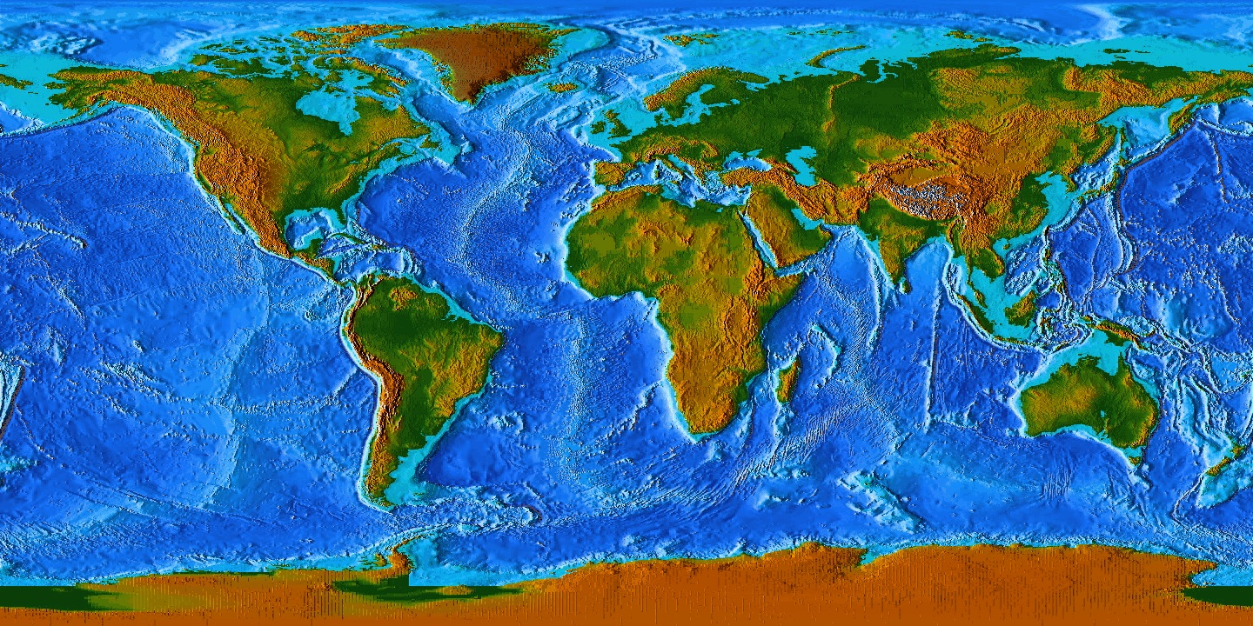
Topographic Map
A map that shows the surface features of an area.
(Page 29)

